Slide 1


Local Search Algorithms
Optimization Problems
No paths, Less memory. Only solution!

Slide 2
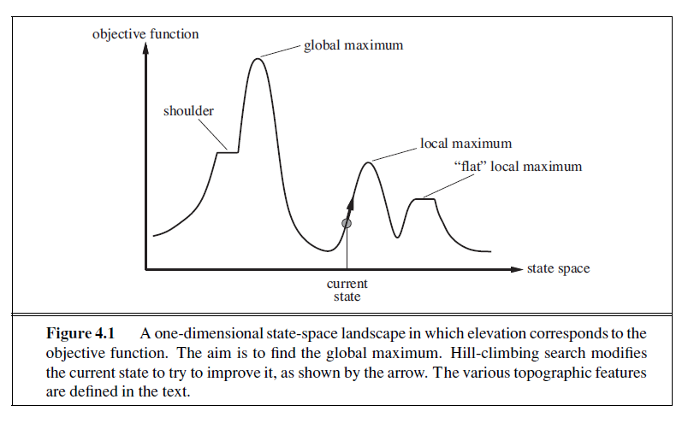











Hill Climbing

Slide 3
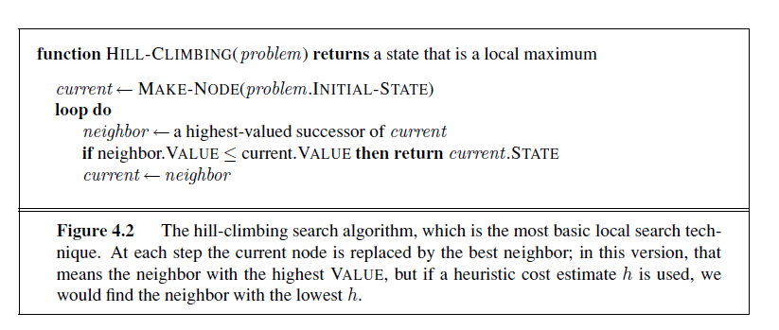


Hill Climbing
Create 2D list of 5x5 with random values.
Find Global Maxima i.e. cell with max value?
Initial state is i,j = 2, 2
Find only four neighbors i.e. up, left, down, right
Handle border cells having less neighbors

Slide 4
Grid or 2D List
2 | 5 | 6 | 8 | 10
12 | 14 | 16 | 55 | 0
9 |  | 0

Slide 5
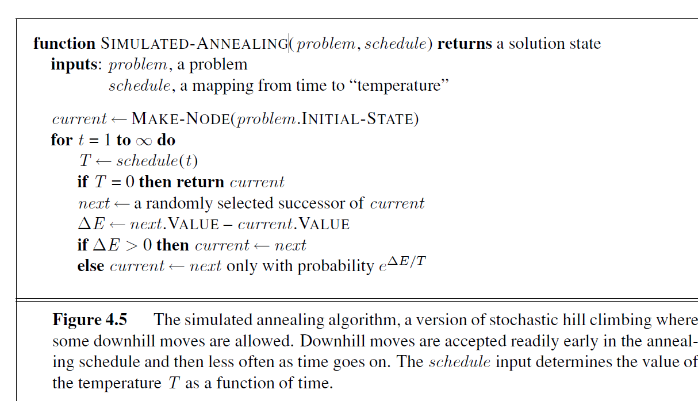
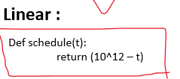




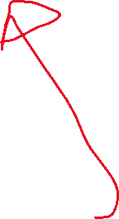






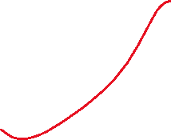




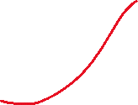


Simulated Annealing

Slide 6




Time (t) to Temperature (T) Mapping
Schedule function (input time) ………..code……….return Temperature
Linear : Exponential:
Def schedule(t):
return (10^12 – t)
i.e.
t=0; 10^12 - 0 = some big value
t=1; 10^12 - 1 = some big value
……….
………..
t=100; 10^12 - 100 = some lesser value
Values are decreasing Linearly!
Def schedule(t):
return (10^12 – e^t) # e = 2.71
i.e.
t=1; 10^12 – 2.71 ^ 1 = some big value
t=10; 10^12 – 2.71 ^10 = some big value
……….
………..
t=100; 10^12 – 2.71 ^ 100 = some lesser value
Values are decreasing Exponentially!

